Slide 1

NAGARJUNA COLLEGE OF ENGINEERING AND TECHNOLOGY VENKATAGIRI KOTE POST, DEVANAHALLI, BENGALURU - 562164 DEPARTMENT OF COMPUTER SCIENCE AND ENGINEERING
TECHNICAL PAPER PRESENTATION
- ANANYASHREE K G
1NC21CS009

Slide 2
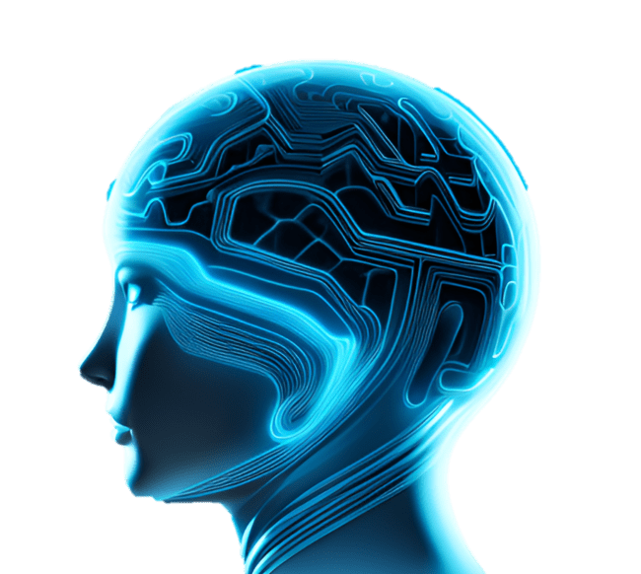
THE BLUE BRAIN

Slide 3
CONTENT
ABSTRACT
INTRODUCTION
HOW BRAIN WORKS
ARTIFICIAL NEURON
BLUE BRAIN
HOW ITS BUILD
HARDWARE COMPONENTS USED
PROS / CONS
MY IDEA
CONCLUSION

Slide 4
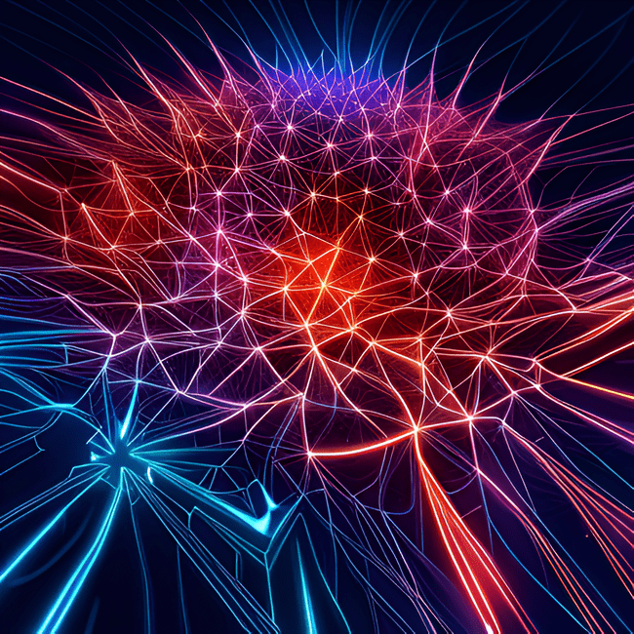
ABSTRACT
The purpose of the artificial brain is to connect the human brain and an artificial brain.
So that a machine can work like a human Brain, and essential information about a person, especially their knowledge, feelings, and memories, can be downloaded to an artificial brain using high-level computational algorithms and supercomputers with a lot of storage space.

Slide 5
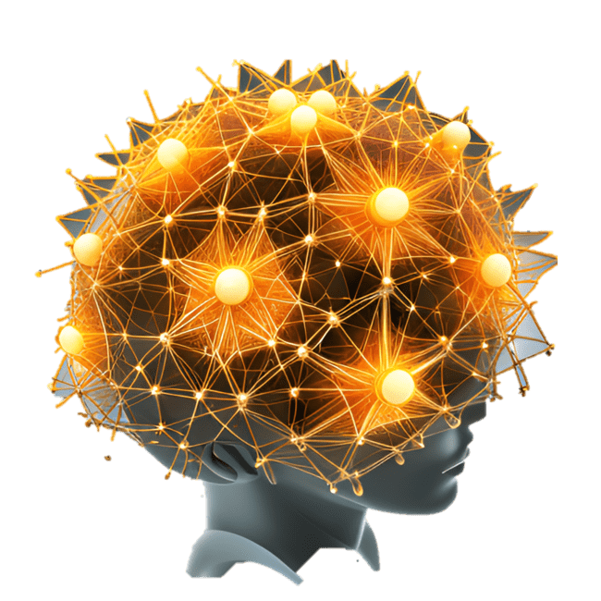
INTRODUCTION
The capacity of a Human Brain is too regulate his environment is what distinguishes him from other.
Intelligence refers to understanding, Thinking, Acting, Interpreting and Predicting future relationships, Concepts..etc
It is to develop Biomedical Simulations, this refers to computer is capable of functioning similarity to a Human Brain.

Slide 6

HOW BRAIN WORKS
By nervous System.
Each neuron is linked by a connection link with another Neuron.
Each is associated with a weight input signal information.
The weight state of a neuron stimulates or inhabits the signal.
By this, Neurons are considered as building blocks of the neural Networks.

Slide 7
ARTIFICIAL NEURON
An Artificial Neuron is a computer model of real Neuron.
Neurons
ALGORITHM USED:
BLACK PROPAGATION ALGORITHM
THE WETWARE ALGORITHM
FUZZY LOGIC
Input
Output
Synapses

Slide 8
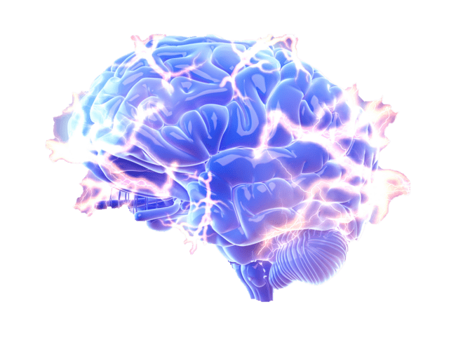
BLUE BRAIN
Important mainstream research is performed in the animal brains to compare, contrast and simulate, build quicker super-computers.
After death, intelligence and the body are lost. The virtual brain solves this problem. And after death, brain and intelligence will be alive.
These robots are tiny enough to fly through all of our circulatory systems. To track the function and structure of our central nervous system, you move to the spine and brain.
Nanobots may also perform a detailed scan of our brain structure and read the association of each neuron.

Slide 9
HOW ITS BUILD.?
The Blue Brain SDK is a Java/Python wrapped C++ library. NEURON is the current neural simulation application.
This software models neuronal cells across different Ion channels by modeling ion streams in and out of the cell.
These movements create an electric potential differential between the inside and outside of the neuronal membrane and enable different neurons to communicate.
The Blue Brain Project's primary application for visualizing neural simulations is RT Neuron.
RT Neuron may use Huxley's output from the Hodgkin simulation as the input to NEURON in order to deliver it in 3D.

Slide 10
HARDWARE COMPONENTS
A great machine.
Memory with wide storage capacity.
Very high power processor.
A rather wide network.
Very strong nanobots to connect the natural brain.
A programme
RATHER THAN THAT
BLUE GENE-P
JuQUEEN
DEEP

Slide 11
PROS CONS
To identify the fundamentals principles of brain structure and function.
To examine treatments for various brain diseases.
Vital role in life disabled people as through this project, then they can share their feeling.
It may increase our dependency on computer.
Once the human brain are uploaded into an artificial one, it may be used against him or her.

Slide 12

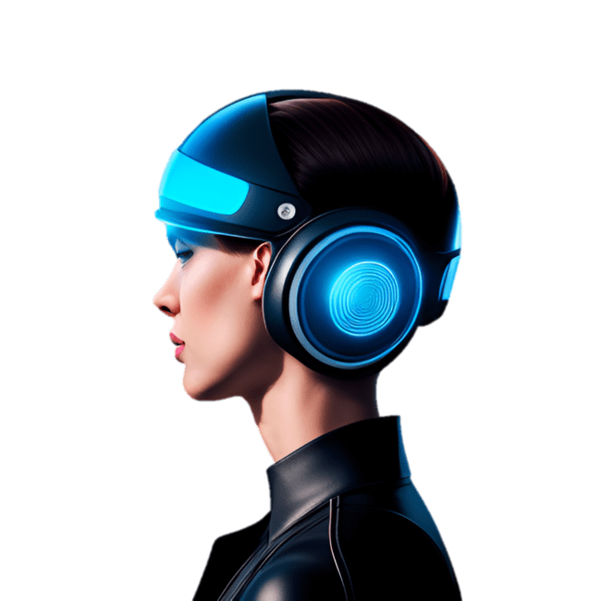
MY IDEA
MENTAL ILLNESS PEOPLE
BCI – BRAIN COMPUTER INTERFACE
(EEG, MEG, EOG, MRI)
TO FIND WHICH IS INACTIVE WE USE THESE METHOD AS BY SENDING NANO BOTS ACCURATELY.
THEN ACTIVATE THE INACTIVE VITAL NERVERS /DAMAGED NERVES

Slide 13
CONCLUSION
The BLUE BRAIN Project represents a significant
step forward in our understanding of the brain. The
Project’s innovative techniques and technologies have the
Potential to revolutionize neuroscience and medicine,
and its success could have far-reaching implications for
society as a whole.
By continuing to push the boundaries of what is possible,
the project’s researchers are helping to unlock the secrets
of Brain.

Slide 14
THANK YOU…!!

